Slide 1
Car Accident Severity

Slide 2
Introduction to the Problem
Weather acts through visibility impairments, precipitation, high winds, and temperature extremes to affect driver capabilities, vehicle performance.
This study tries to determine the correlation between weather conditions and traffic accident occurrences by analyzing collected data. Data analysis is one of the activities of data science focused on obtaining important information from collected data
To reduce the frequency of car collisions in a community, an algorithm must be developed to predict the severity of an accident given the current weather, road and visibility conditions. When conditions are bad, this model will alert drivers to remind them to be more careful or possible change travel date, mode or time, so that it would be safer.

Slide 3
Target Audience
Daily commuters, who have travel on a regular basis for work. This project would warn them of possible dangers while driving based on the weather condition, road conditions and the time of the day
It would also help the first responders like ambulance and firefighter services. The system could help them stay prepared in advance by indicating them of high chances of accidents that could take place.
Thus, ensuring anyone in need could receive their help without much delay

Slide 4
Data Understanding
The data has been retrieved and processed through various sources, and database.
The main source being the data-collisions csv file
Our predictor or target variable will be 'SEVERITYCODE' because it is used measure the severity of an accident from 0 to 5 within the dataset. Attributes used to weigh the severity of an accident are 'WEATHER', 'ROADCOND' and 'LIGHTCOND'

Slide 5
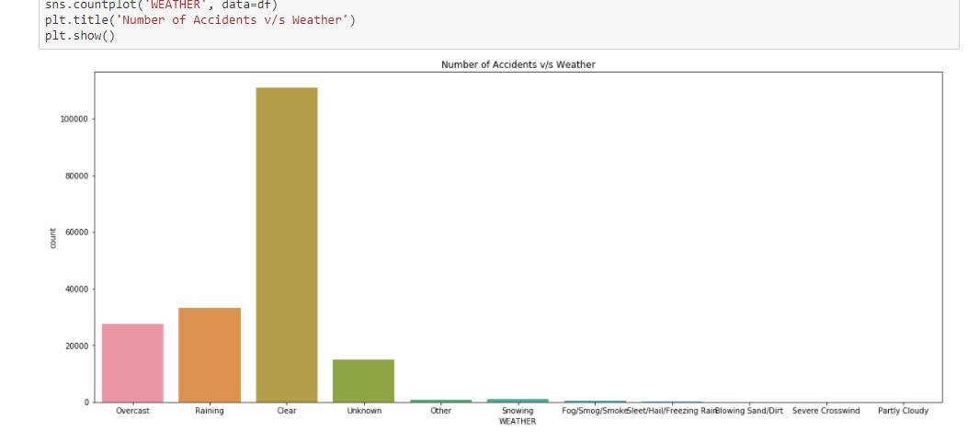
Number of Accidents v/s Weather:
The graph determines the most of accidents take place in clear weather, and other weather conditions which also cause some of the accidents are Overcast and Rain.
So we can ignore the other weather conditions
Overcast: Overcast sky conditions occur when clouds cover all or most of the sky and cause low visibility conditions
Rains: Heavy or moderate rainfall, which causes roads to be slippery
Clear: Clear weather conditions

Slide 6
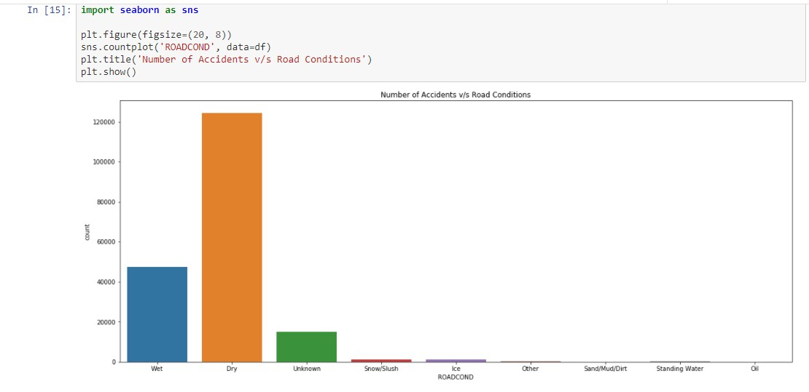
Number of Accidents v/s Road Conditions:
Most of the accidents took place on dry road conditions, and the other condition which also caused a few accidents was wet road conditions, other conditions can be ignored
This attribute refers to the road condition for a day
Wet: Usually refers to wet and snowy conditions on a day
Dry: Normal road conditions

Slide 7
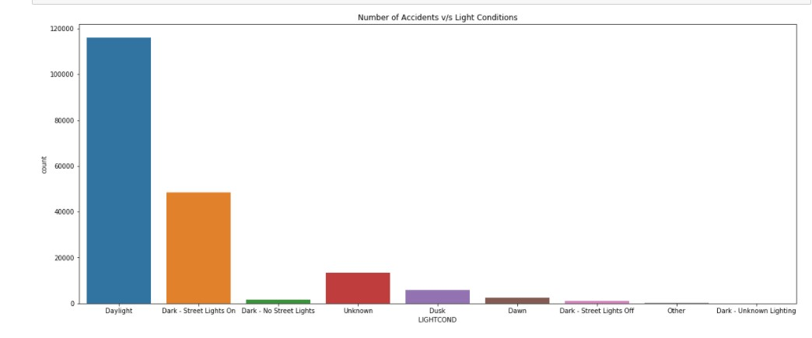
Number of Accidents v/s Light Conditions:
Most of the accidents were caused during daylight, the other major cause of accidents was Dark with streetlights on, the other features can be ignored
This attribute gives information of light conditions when the accident took place and will be useful in predicting in what conditions an accident is probable.
Daylight: Indicates daylight conditions
Dark with Street Lights on: Dark conditions but streetlight source was present
Dark without Street Lights: Pitch dark conditions, only head lights to guide the way
Dawn: Early Morning, day starts getting more light
Dusk: late evening, light from the day reduces

Slide 8
Data Balancing and Cleaning
Cleaning
Data Understanding
Data is unbalanced and cannot be directly used for analysis
In its original form, this data is not fit for analysis. For one, there are many columns that we will not use for this model. Also, most of the features are of type object when they should be numerical type.
We must use label encoding to covert the features to our desired data type.
Data Cleaning is an essential step because we must identify which data features are important for our analysis and which attributes are not.
So, it is essential that we go through each attribute carefully and determine how important it is and whether it can be used

Slide 9
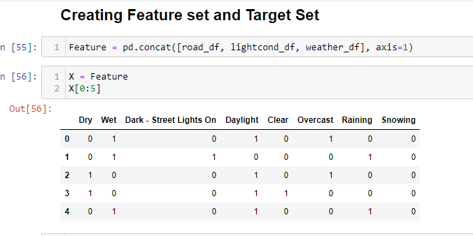
Data Preprocessing
Since most of the data like ‘WEATHER’, ‘ROADCOND’, ‘LIGHTCOND’ are all categoric, since most of the data like ‘WEATHER’, ‘ROADCOND’, ‘LIGHTCOND’ are all categoric
They must be converted to numeric type so they can be fed as feature set for Classifier Models:

Slide 10
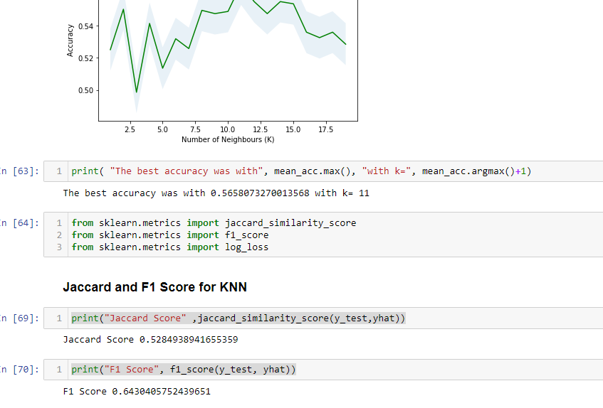
KNN Model
KNN yielded:
Jaccard Score: 0.528
F1 Score: 0.64
K for best Accuracy: 11

Slide 11
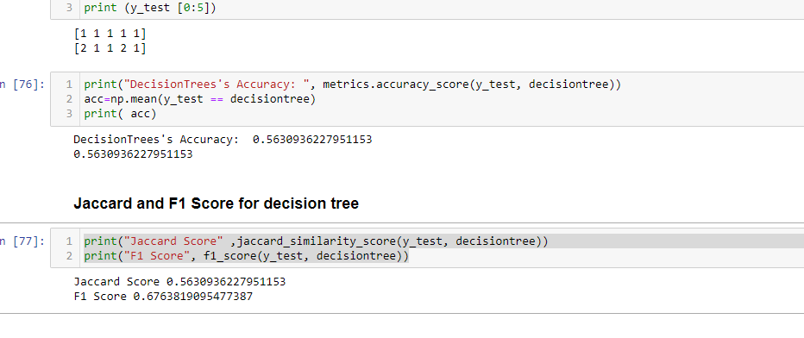
Decision Tree
Decision Tree yielded:
Jaccard Score: 0.563
F1 Score: 0.676

Slide 12
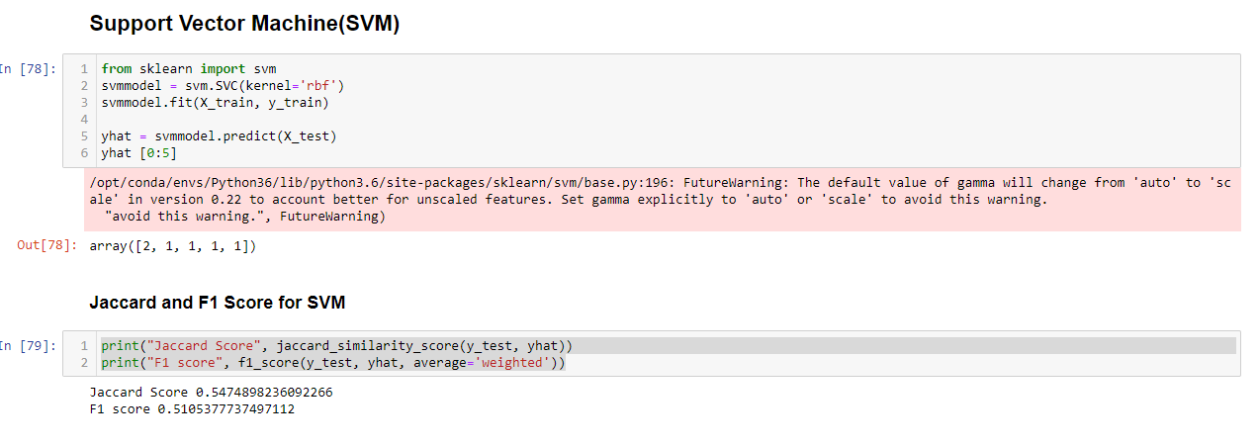
Support Vector Machine(SVM):
SVM yielded:
Jaccard Score: 0.547
F1 Score: 0.501

Slide 13
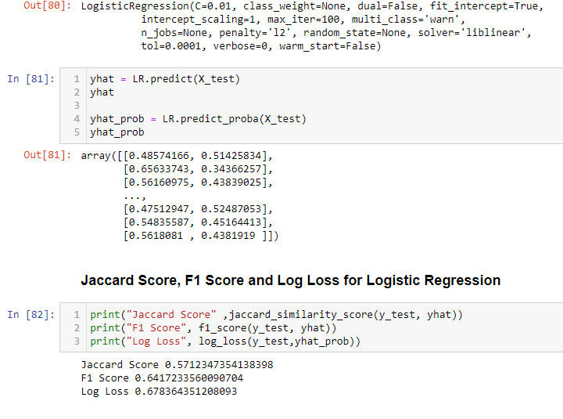
Logistic Regression:
Logistic Regression Yielded:
Jaccard Score: 0.5712
F1 Score: 0.6417
Log Loss: 0.678

Slide 14
CONCLUSION
Using the existing dataset of the course, some remarkable insights have been obtained. At the beginning it was guessed, that the severity of an accident could be predicted by the weather or speeding conditions. Using different methods for estimation of the severity based on the existing dataset it could be observed, that only small amount of information can be gained by predictions.

